Slide 1

Programming Languages
Design goals

Slide 2
Language Attributes
Easy to compile
Efficient execution – single core vs multi-core
Platform independence
Binding – early vs late
Evaluation – strict vs non-strict
Simple syntax
Simple semantics

Slide 3
Continued…
Referential transparency
Orthogonality
Generality
Uniformity
…

Slide 4
Generality
Concerns itself with the restrictions (if any) to what you can do with a “thing”
Constant identifier
Restriction = the kind of expression that can be assigned to the identifier (e.g., static evaluation)
Arrays
Restriction = cannot perform equality comparison

Slide 5
orthogonality
Concerns itself with the restrictions (if any) on the context of where a “thing” can be used.
Expressions in the context of constant declarations
Restriction = must be able to evaluate statically
Equality operator in the context of array expressions
Restriction = cannot be used to compare arrays

Slide 6
A code fragment
…
x = 5;
y = x++ + x;
print(y);
…

Slide 7
Uniformity
Similar things should look similar and different things should look different.
Return values in Pascal functions look like assignments
While-statements in Pascal begin a block, but if-statements do not.
Semi-colon as statement separator as well as a statement terminator (?)

Slide 8
Design for automated support
“Maximize the number of errors that could not be made”
- C.A.R. Hoare

Slide 9
Static Analysis
Require variables to be declared
Require variable types to be explicitly declared
Assure operators are only applied to values for which they are defined
Syntax directed editors (structure editors)
Theoretical limitations

Slide 10
Dynamic (runtime) Analysis
Array bounds
Divide by zero
Exceeding max int
Pointer checks (e.g., null pointer exception)

Slide 11
Programming Paradigms
Imperative, functional, declarative, object-oriented, aspect-oriented

Slide 12
Imperative (procedural)
Implicit notion of “state”
Based on the assignment statement
Result of a computation is a “state” that can be inspected via I/O operations
Successful Languages: Pascal, Basic, Fortran, C

Slide 13
Functional (applicative)
Based on function calls
The result of a computation is a value
Often easier to reason about and manipulate
Successful Languages: Lisp, SML, Haskell

Slide 14
Logic (declarative)
Based on properties (e.g., horn-clauses)
The result of a program is a unification (and proof)
Complex control provided by the system (e.g., backtracking)
Successful Languages: Prolog (and dialects of Prolog)

Slide 15
Object Oriented
Centered around the notion of an “object”
Often used to extend imperative programming
Successful Languages: Smalltalk, C++ and Java

Slide 16
Though OOP came from many motivations, two were central. The large scale one was to find a better module scheme for complex systems involving hiding of details, and the small scale one was to find a more flexible version of assignment, and then to try to eliminate it altogether.
Alan Kay
The Early History of Smalltalk

Slide 17
Aspect Oriented
Centered around the notion of an “aspect”
Combines transformation with another language paradigm (typically the OO paradigm).
Successful Languages: AspectJ (and dialects)

Slide 18
Example
Implementing Euclid’s GCD algorithm

Slide 19
Tiling a floor
a
b
Notes:
a = 6.0
b = 3.6

Slide 20
Common Measure (AKA common factor)
a
b
Notes:
a = 3.6, b = 6.0

Slide 21

A common unit of measure
side a = 5 * unit
side b = 3 * unit
Note that both 5 and 3 are integers.

Slide 22
Definition of GCD
Assume u and v are not both 0.
gcd(u,v) is the largest integer x such that the following holds.
∃ a,b : a * x = u ∧ b * x = v

Slide 23
Euclid’s ALgorithm
Given (u,v) where
u and v are non-negative integers
u and v are not both 0
gcd(0,v) = v
gcd(u,0) = u
gcd(u,v) = gcd(v, u mod v) note that v ≥ u mod v

Slide 24
Example
gcd(100,75) = gcd(75,25)
= gcd(25,0)
= 25

Slide 25
Java/C
x = u;
y = v;
while (y > 0) {
t = x % y;
x = y;
y = t;
}
Note that we generally do not want to overwrite the values in u
and v, thus we need to store our own copies (x and y).
Notes:
Notice y > 0 was written and not y != 0.

Slide 26
Modula-2
x := u;
y := v;
LOOP
IF y <= 0 THEN
EXIT
END;
t := y;
y := x MOD y;
x := t
END;
Notes:
The negation of y > 0 is y <= 0

Slide 27
Lisp
(define (gcd u v)
(if (= v 0) u
(gcd v (remainder u v))))

Slide 28
Prolog
gcd(U,0,U).
gcd(U,V,X) :- V > 0,
Y is U mod V,
gcd(V,Y,X).

Slide 29
SML
fun gcd(x,0) = x
| gcd(x,y) = gcd(y,x mod y);

Slide 30
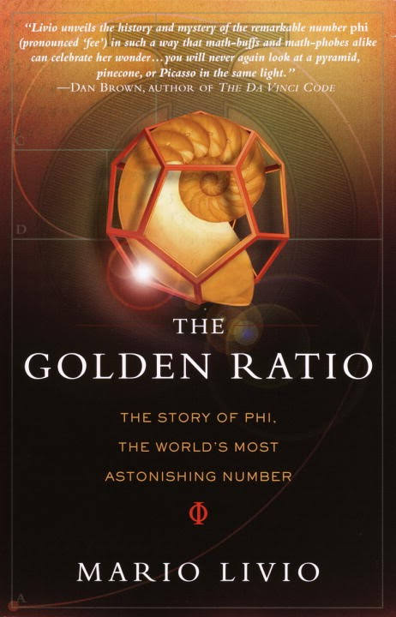
The golden ratio
A variation of Euclid’s tiling problem

Slide 31
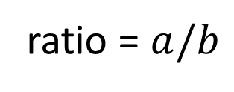
The Ratio of a rectangle
a
b
ratio = $a/b$

Slide 32
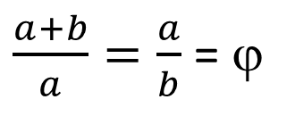

a
b
a
Ratio = $\left(a+b\right)/a$
These two rectangles have a divine proportion if:
$\frac{a+b}{a}=\frac{a}{b}$ = ϕ

Slide 33
Incommensurability
A rectangle having a divine proportion has no common unit of measure!
More specifically, there is no “unit” u such that the width of the rectangle is an integer multiple of u and the height of the rectangle is also an integer multiple of u.
Another way of saying this is that the divine proportion is an irrational number.
Notes:
The usage primarily comes to us from translations of Euclid's Elements, in which two line segments a and b are called commensurable precisely if there is some third segment c that can be laid end-to-end a whole number of times to produce a segment congruent to a, and also, with a different whole number, a segment congruent to b. Euclid did not use any concept of real number, but he used a notion of congruence of line segments, and of one such segment being longer or shorter than another.
That a/b is rational is a necessary and sufficient condition for the existence of some real number c, and integers m and n, such that
a = mc and b = nc.Assuming for simplicity that a and b are positive, one can say that a ruler, marked off in units of length c, could be used to measure out both a line segment of length a, and one of length b. That is, there is a common unit of length in terms of which a and b can both be measured; this is the origin of the term. Otherwise the pair a and b are incommensurable.

Slide 34
The phrase "without common measure" is converted into "without common language". To state that two theories are incommensurable means that there is no neutral language, or other type of language, into which both theories, conceived as sets of statements, can be translated without remainder or loss... [Although] the majority of the terms shared by the two theories function in the same way in both...
— Thomas Kuhn

Slide 35
The End

